Slide 1
HelpDesk
Created and Presented by :
Sai Harika Prathi -15WH1A0561
Jyothi Marikonda-15WH1A05A1
Apoorwa Sajjanapu-15WH1A05A9
M.Pooja-15WH1A05B7
BVRIT Institute Of Technology For Women
June (01-10) 2017

Slide 2
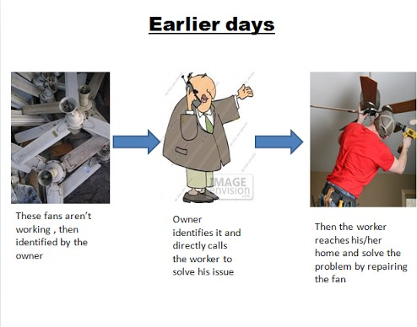

Slide 3
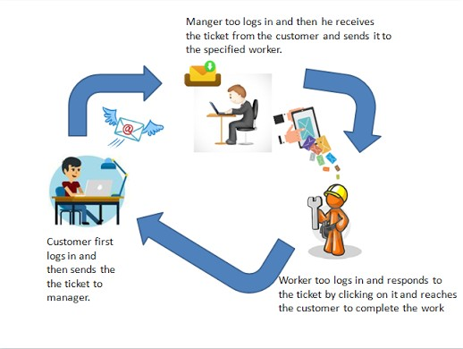
Skeleton of our project:

Slide 4
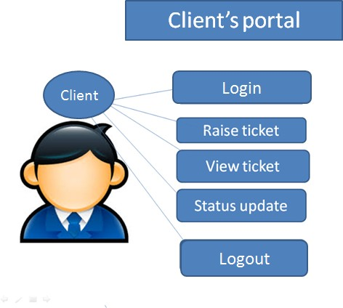

Slide 5
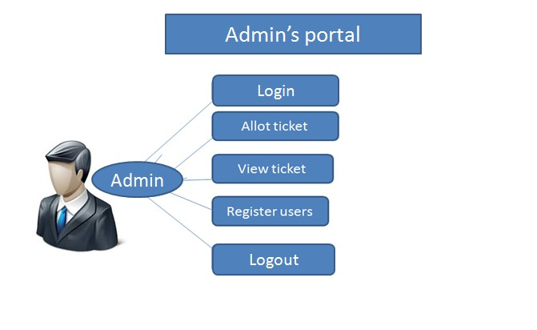

Slide 6
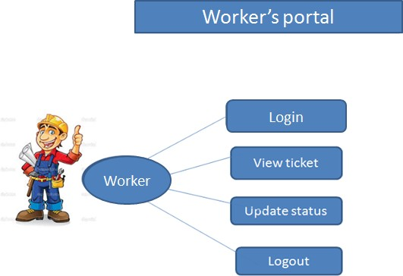

Slide 7
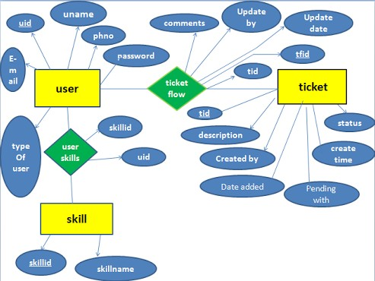
Schema:

Slide 8
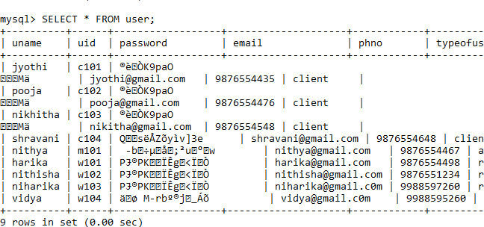
User:

Slide 9
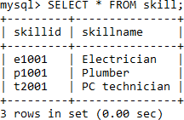
Skill:

Slide 10
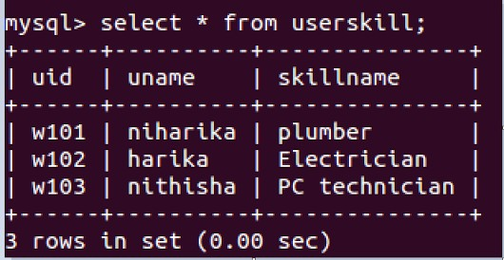
UserSkills:

Slide 11
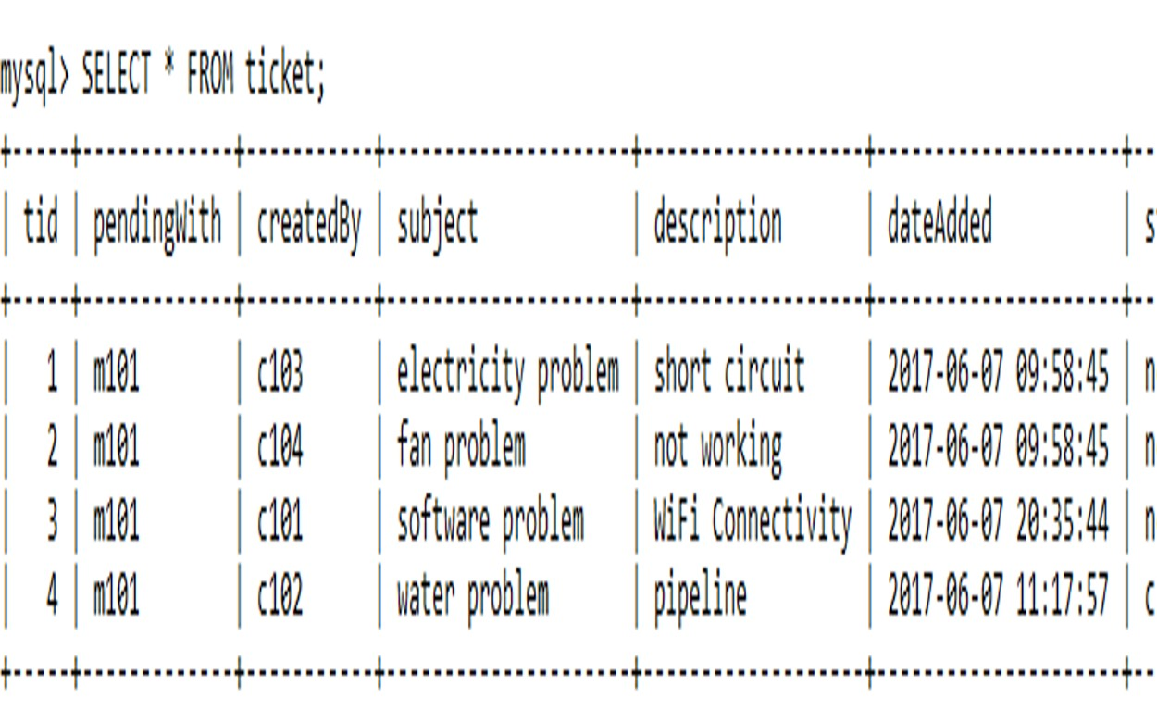
Ticket:

Slide 12

Tools used:

Slide 13
Learnings:
e Implementing the database
e Encrypting the data .
e Automatic increment of the tickets.
e Designing front end.
e Using JDBC effectively.
e Linking web components viz (jsp,servlet,models,dao’s,controller’s,pojo’s).
e Working in a team.
e Using centralised repository(GitHub).
e Following MVC architecture.

Slide 14
Challenges:
e Enhancing userinterface

Slide 15
Future Enhancement:
e Forgot password
e Feedback with ratings
e SMS notification to all users

Slide 16


